Slide 1
Install VSCode
https://code.visualstudio.com

Slide 2
Install NodeJS Select Recommended Version
https://nodejs.org

Slide 3
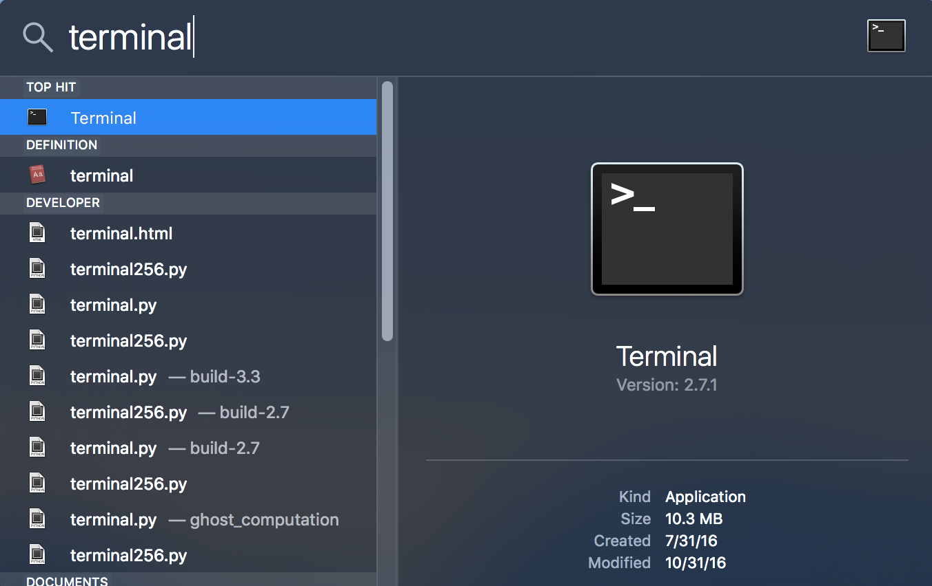
Open Terminal CMD + Space Bar, Terminal

Slide 4
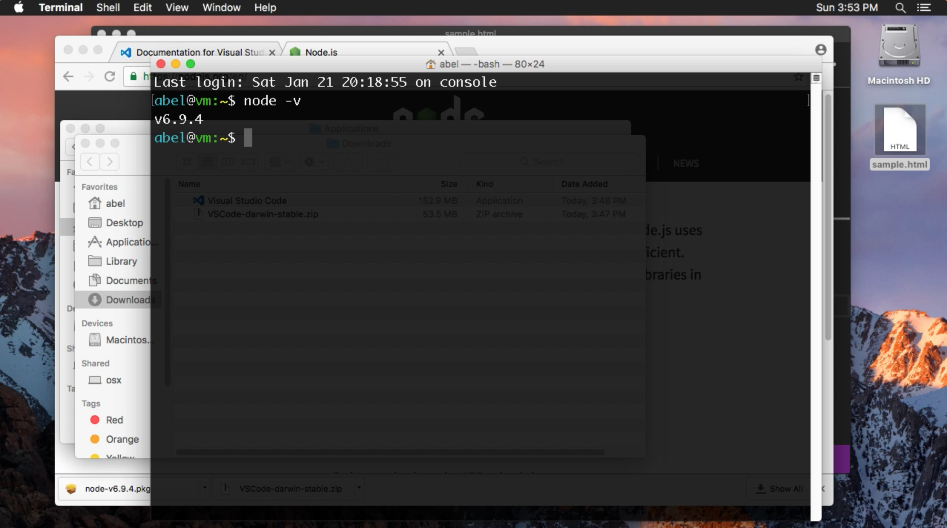
Open Terminal, Confirm Node Installation

Slide 5
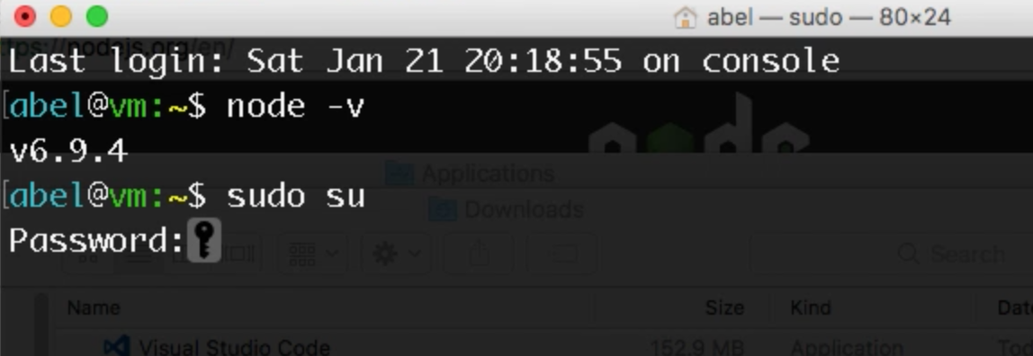
Enter sudo su

Slide 6
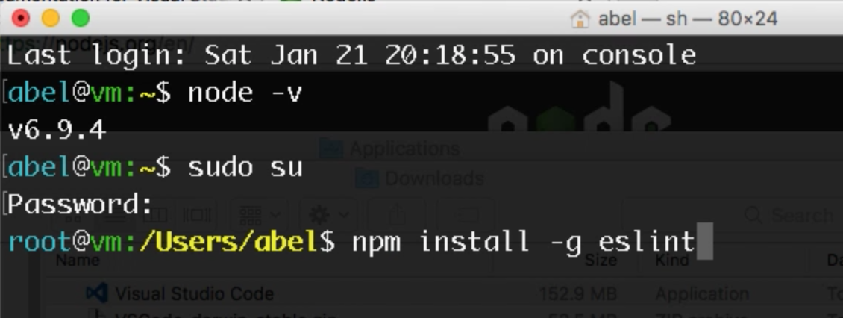
Install eslint
npm install –g eslint

Slide 7

Install eslint-plugin-html
npm install –g eslint-plugin-html

Slide 8
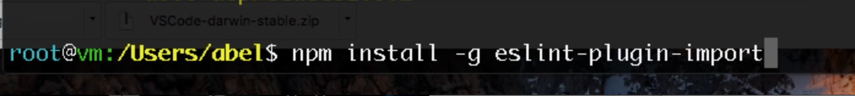
Install eslint-plugin-import
npm install –g eslint-plugin-import

Slide 9
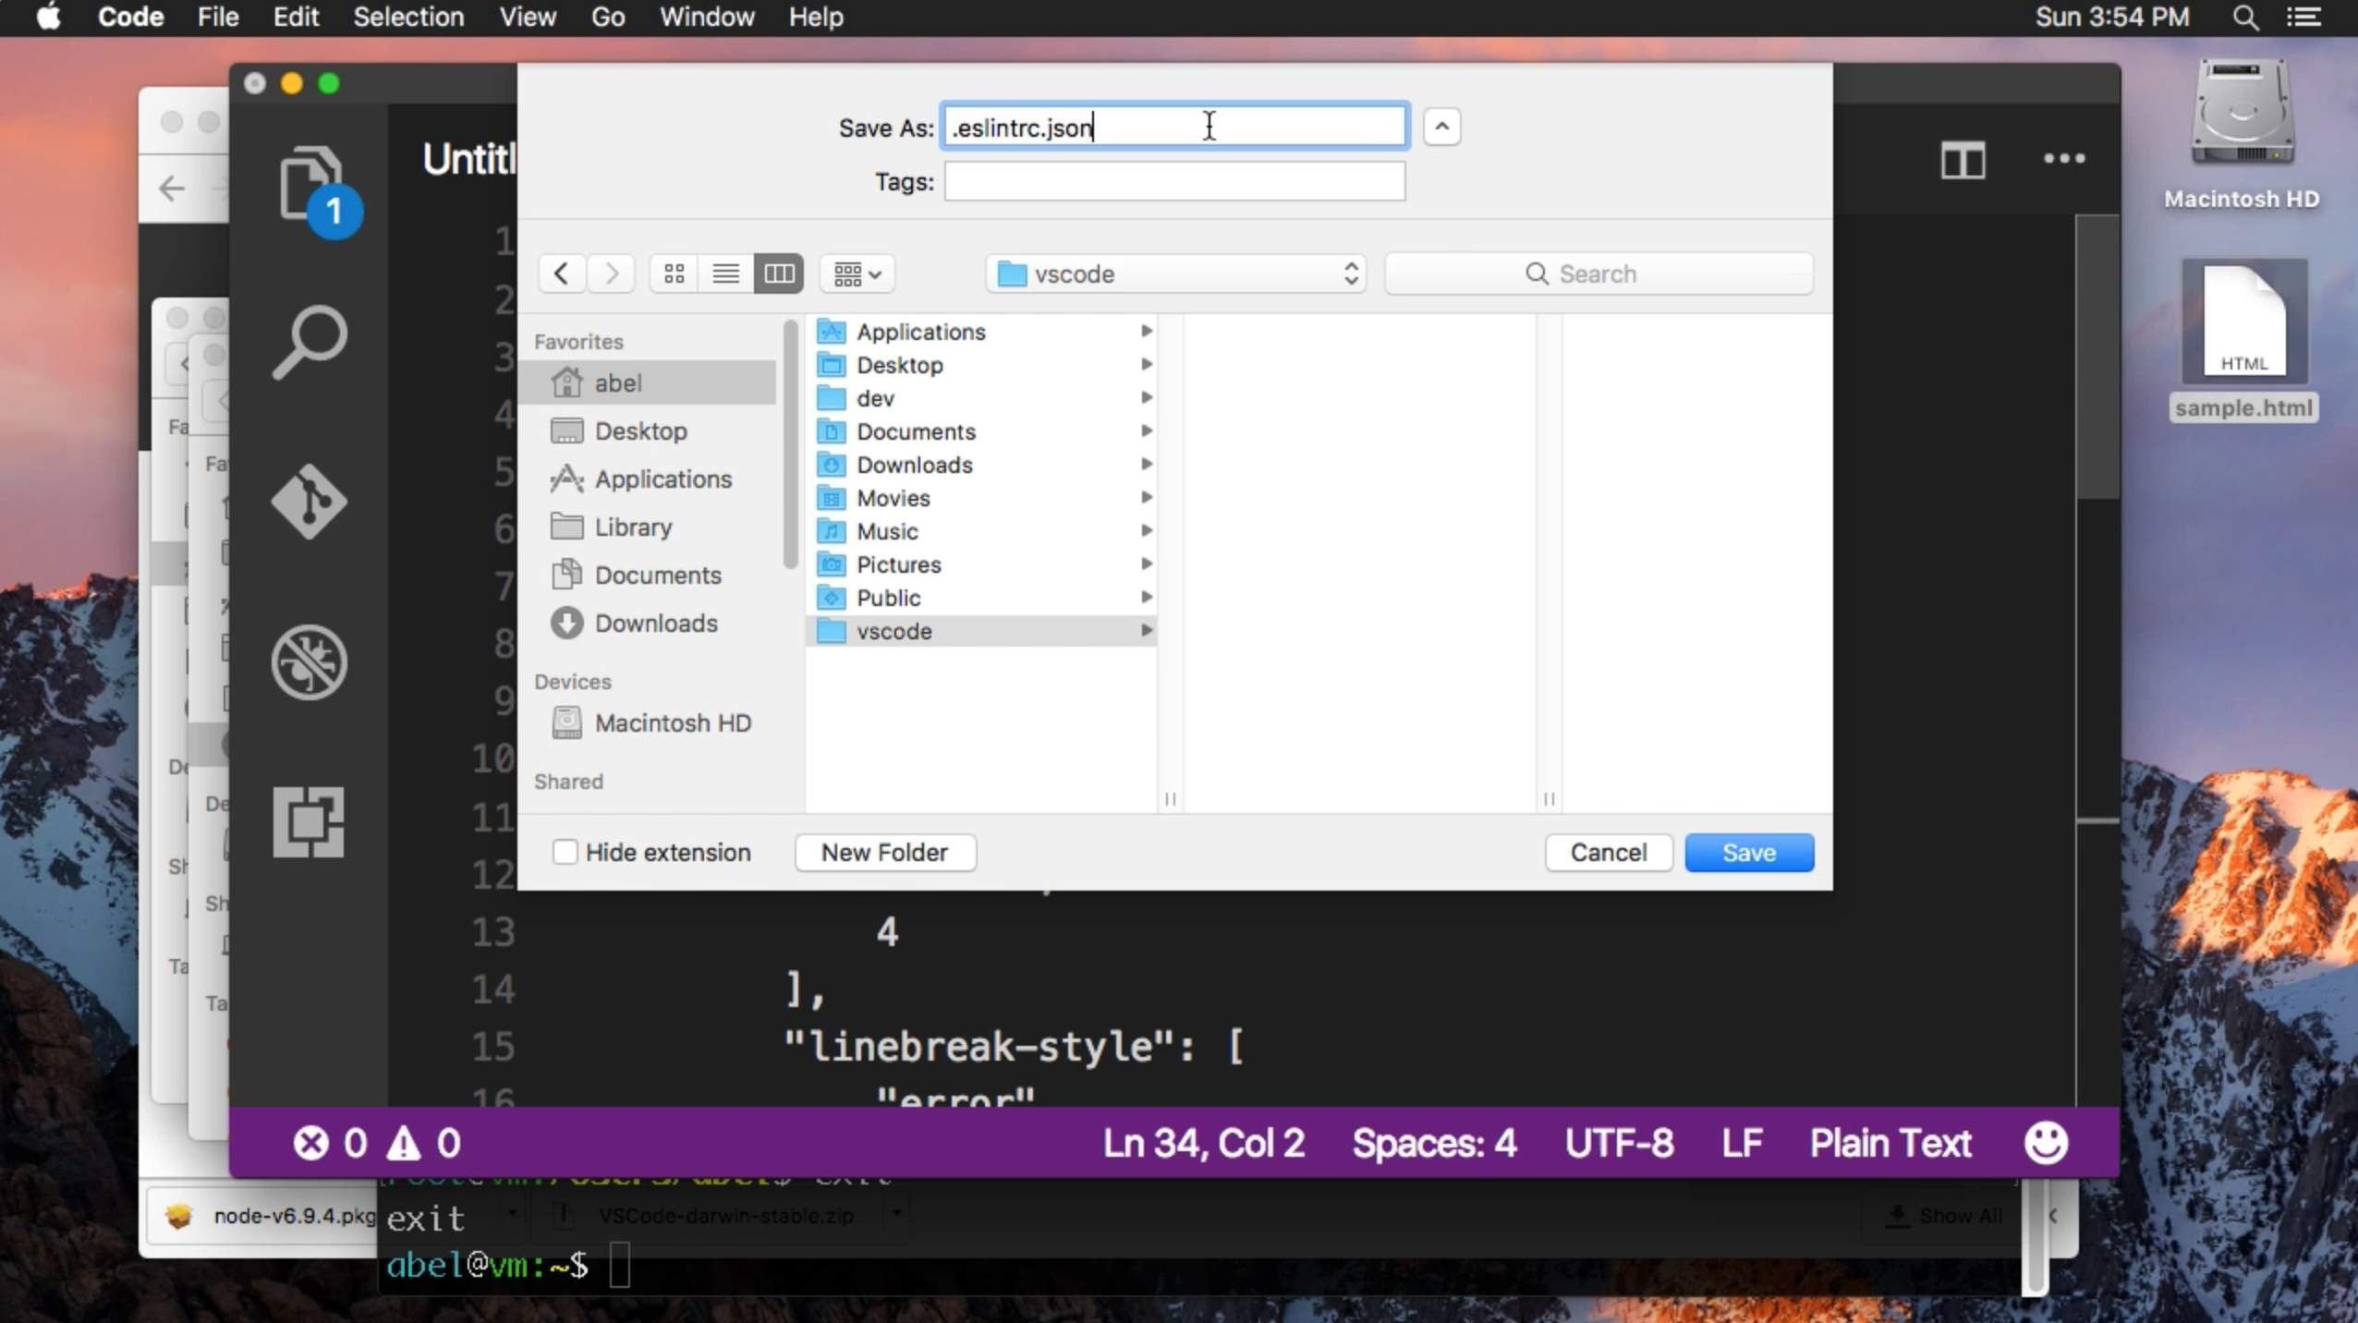
Create .eslintrc.json

Slide 10
Create file: .eslintrc.json
{
"env": {
"browser": true,
"node": true
},
"plugins": [
"import",
"html"
],
"rules": {
"indent": [
"error",
4
],
"linebreak-style": [
"error",
"unix"
],
"quotes": [
"error",
"single"
],
"semi": [
"error",
"always"
],
"no-console": "off"
},
"globals": {
"firebase": true
},
"extends": "eslint:recommended",
"plugin": [ "html" ]
}

Slide 11
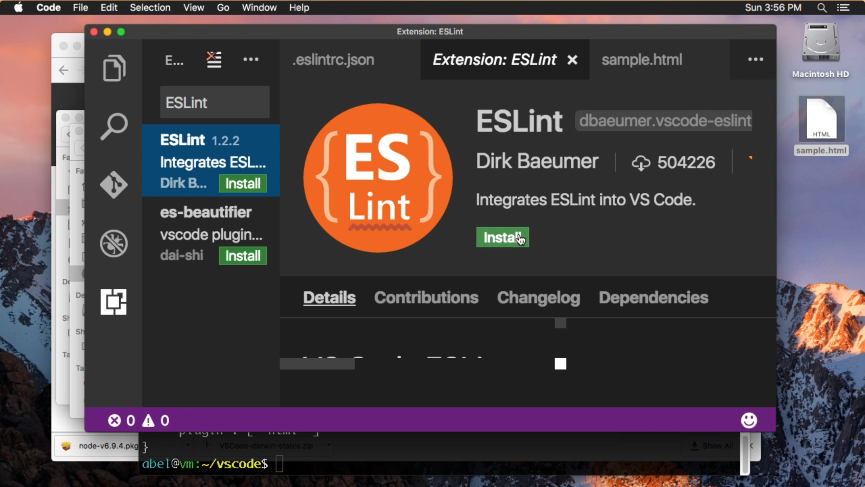
Install ESLint

Slide 12
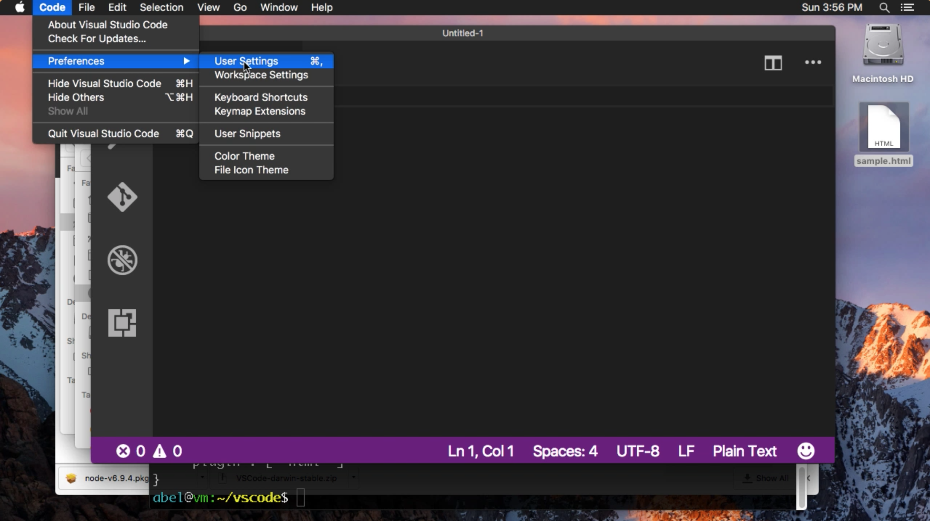
Reference configuration file in user settings

Slide 13
Add configuration to VSCode code -> preferences -> user settings
// add configuration to vscode
// code -> preferences -> user settings
"eslint.options": { "configFile": "/Users/YourUsername/vscode/.eslintrc.json" },
"eslint.validate": [
"javascript", "html"
],
"editor.tabSize": 4,
"editor.insertSpaces": true,
"editor.detectIndentation": false,
"editor.fontSize": 18

